Slide 1


Slide 2
Goal
Build a fully classical computer vision pipeline that detects and classifies traffic signs (STOP, Pedestrian Crossing, Signal Ahead, etc.) using:
HSV color segmentation
SIFT-based template matching with hand-crafted templates
The focus on understanding how well this approach works on around 70 real-world images and where it breaks under challenging conditions.
Why This Matters
Traffic sign detection is a classic intelligent transportation problem, still relevant for ADAS and autonomous driving.
Most modern systems use deep learning, but classical color + template pipelines are still valuable when data or compute are limited.

Slide 3
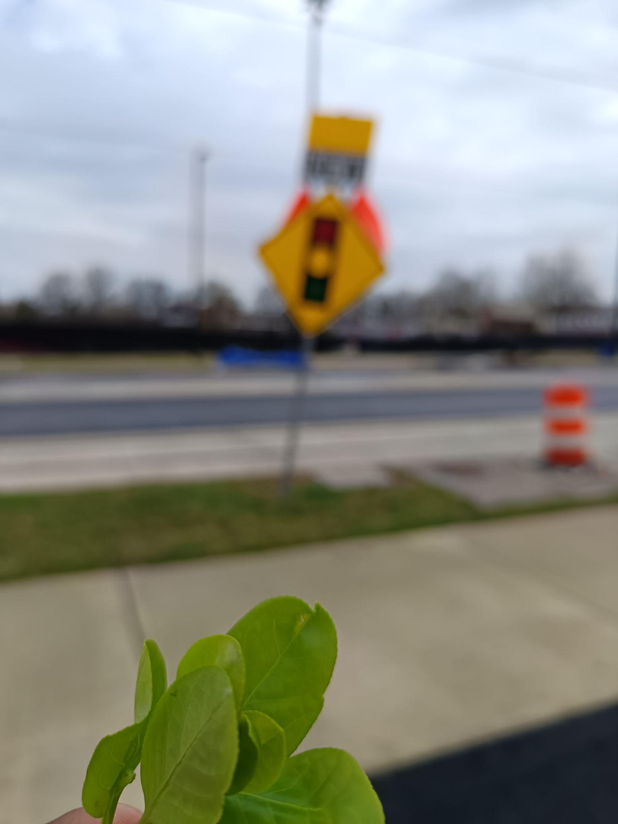
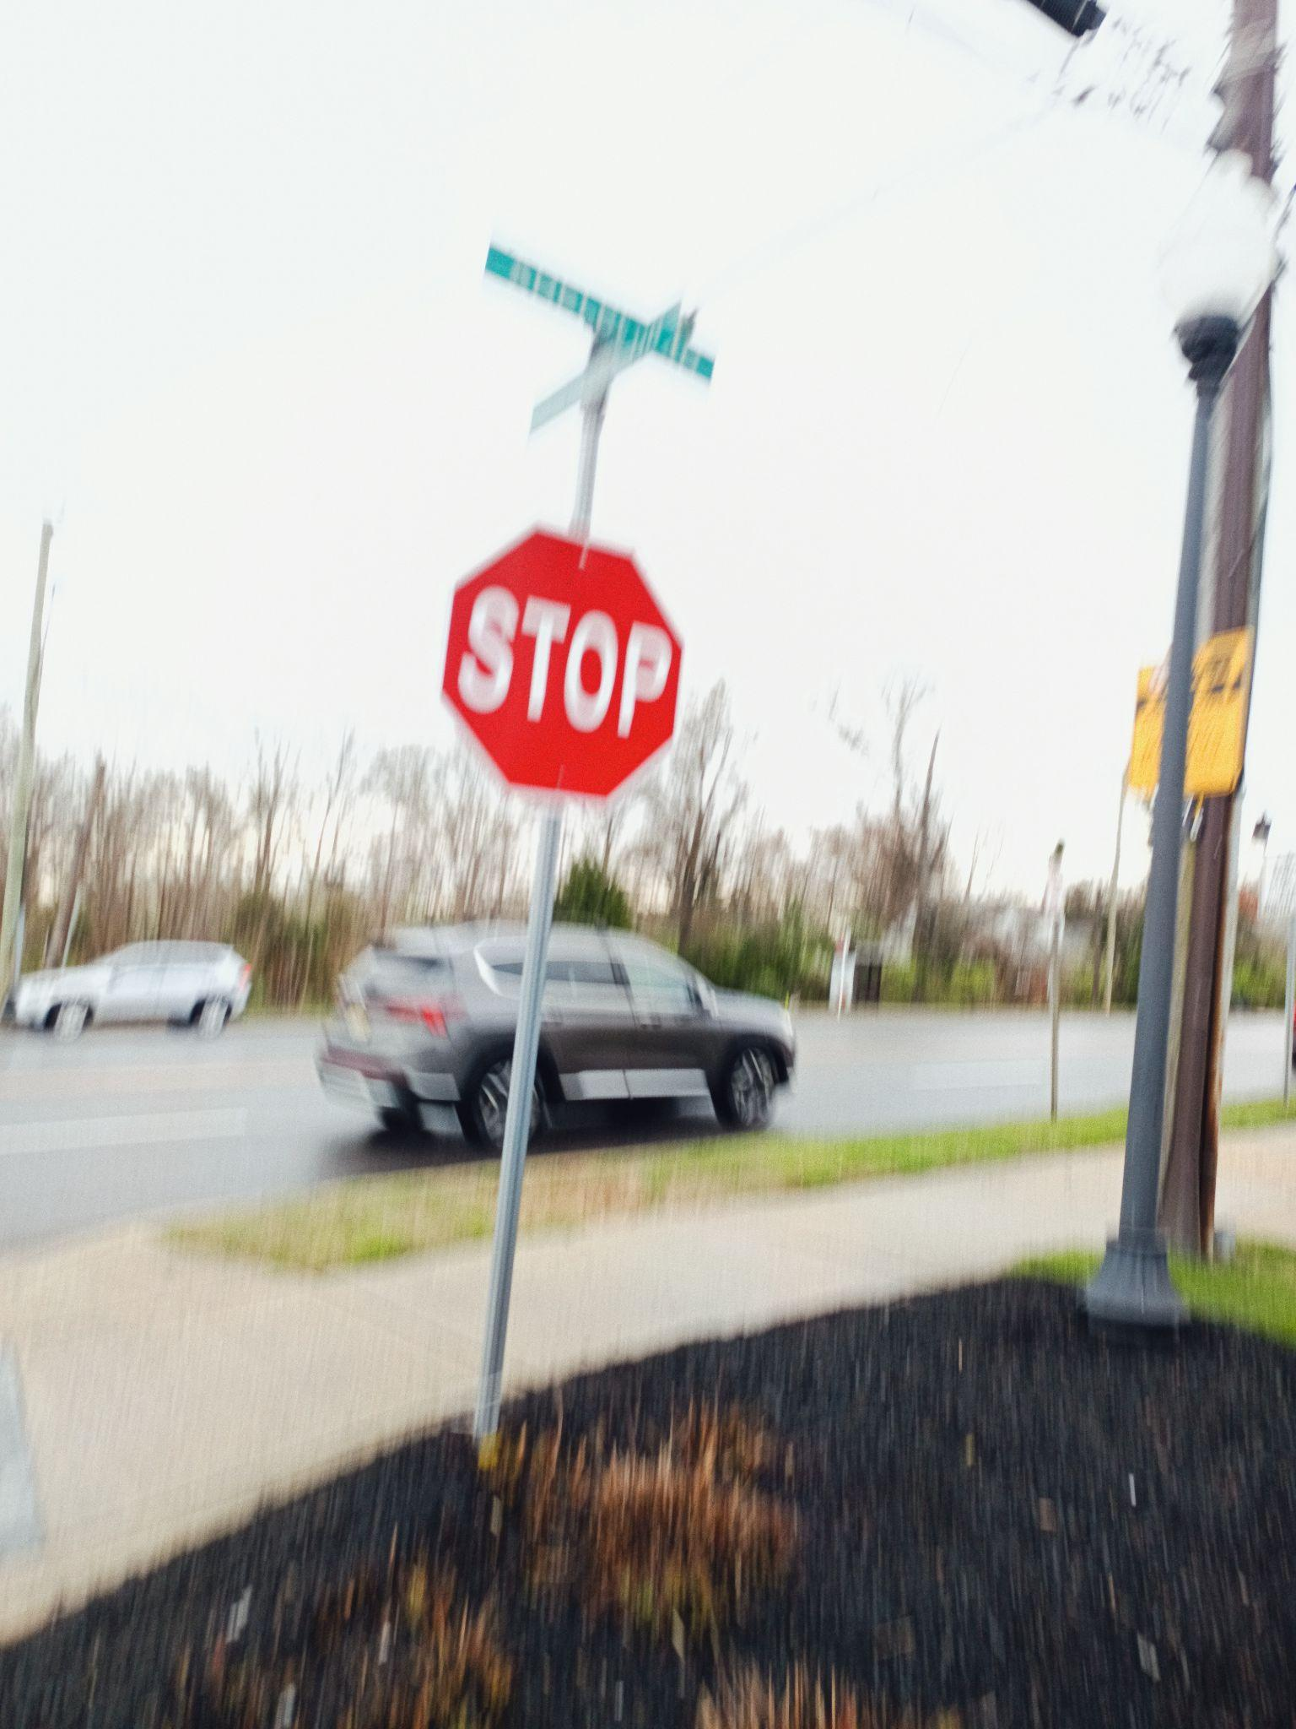
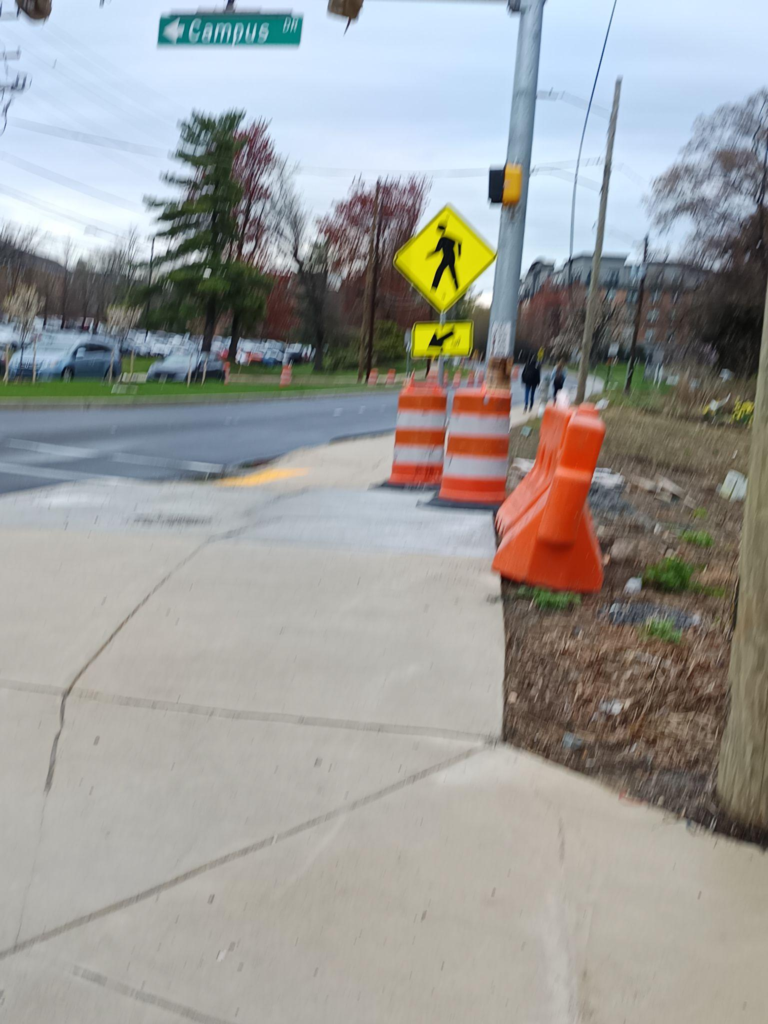
Dataset Composition:
Total of around 70 real-world image of sign types: STOP, Pedestrian Crossing, Signal Ahead.
Around 900 samples of images with 9 classes on Tiny Lisa Dataset.
Data Source:
Self-captured images on phone from local streets and intersections with unfiltered “in-the-wild” conditions.
Tiny Lisa Dataset on Kaggle
Real-World Variability:
Different lighting conditions (bright sun, shadows, overcast, dusk)
Multiple viewing angles (frontal, oblique, tilted)
Varying distances (close-up, medium, far)
Environmental challenges: background clutter, partial occlusion, motion blur

Slide 4
LIVE DEMO

Slide 5
CHALLENGES AND TAKEAWAY
Challenges
In real street photos, roads, trees, cars, and sky compete with the sign. Classical feature matching can’t ignore irrelevant features, so the sign often gets lost.
The same algorithm that finds detail is blind to simple signs
Takeaways
Color and shape are more reliable than texture for signs
Classical CV works best when you reduce the problem before solving it

